Slide 1

What is happening ^{in the} Startup Economy
DAFT BCN 03/2020 - Victoria Zauner – Project 4
…and how to maximize your chances of success
according to data

Slide 2
Project Overview 👀
Choose a topic of ones’ liking
Find data, claim Hypothesis’
Conduct Analyses
Provide insights, including Statistical Insights
Project Goals 🏁
Provide a general overview
Determine Factors for Success
Likelyhood of Success

Slide 3
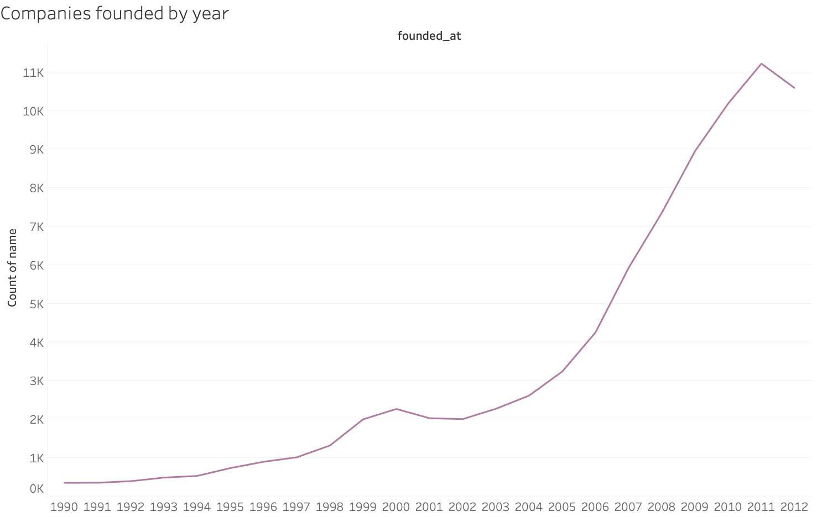
General Analysis of the Data
Number of Companies founded by Year

Slide 4
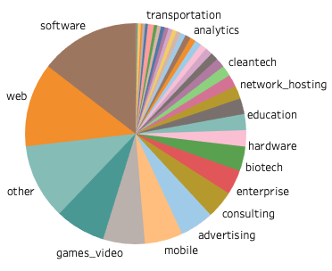
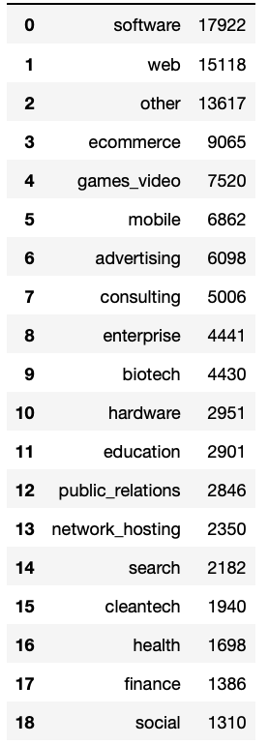
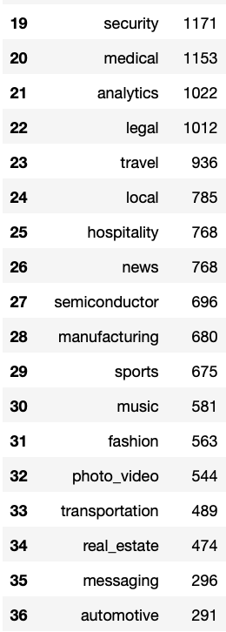
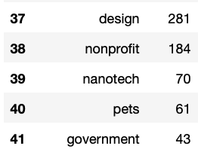
General Analysis of the Data
Number of Companies
Founded by Sector

Slide 5
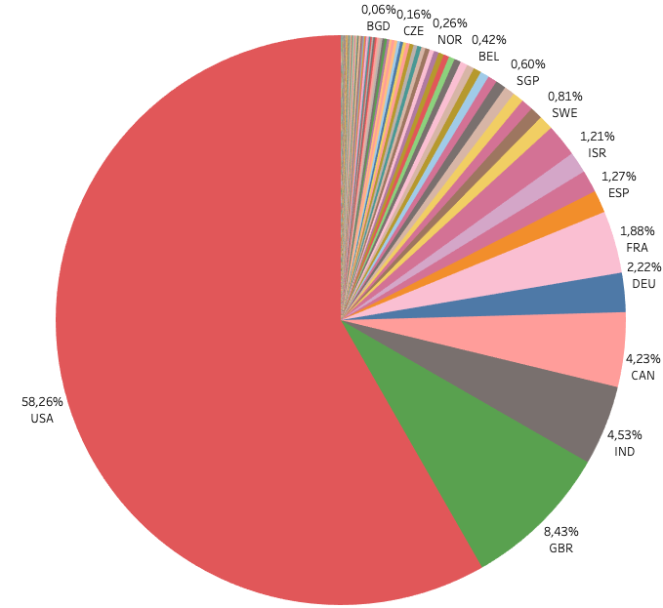
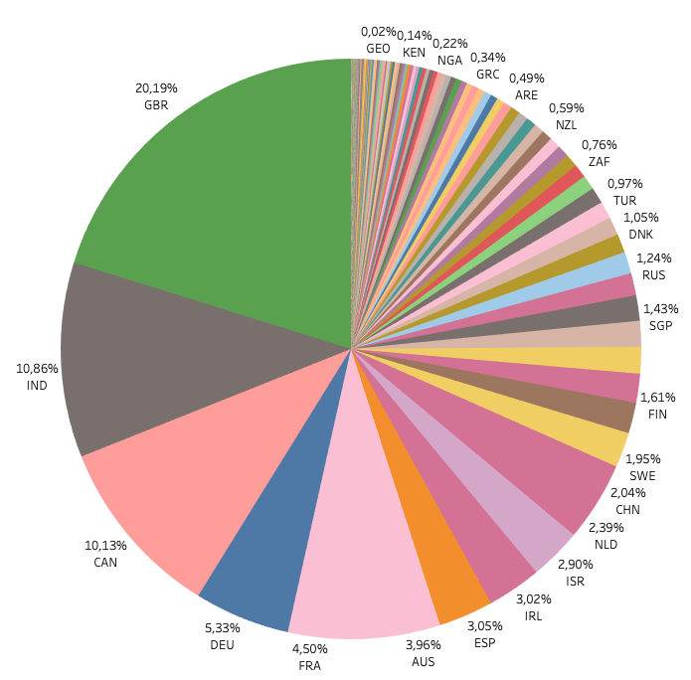
General Analysis of the Data
Number of Companies by Country

Slide 6
Industry Growth Projections
Based on the Past Rates which Industries will grow in the Future?
Underlying Assumption:
The number of companies founded in a particular industry is an indicator for a growth in demand a for innovation and therefore for Sector Growth
No Recession / Same economic conditions as in the past

Slide 7
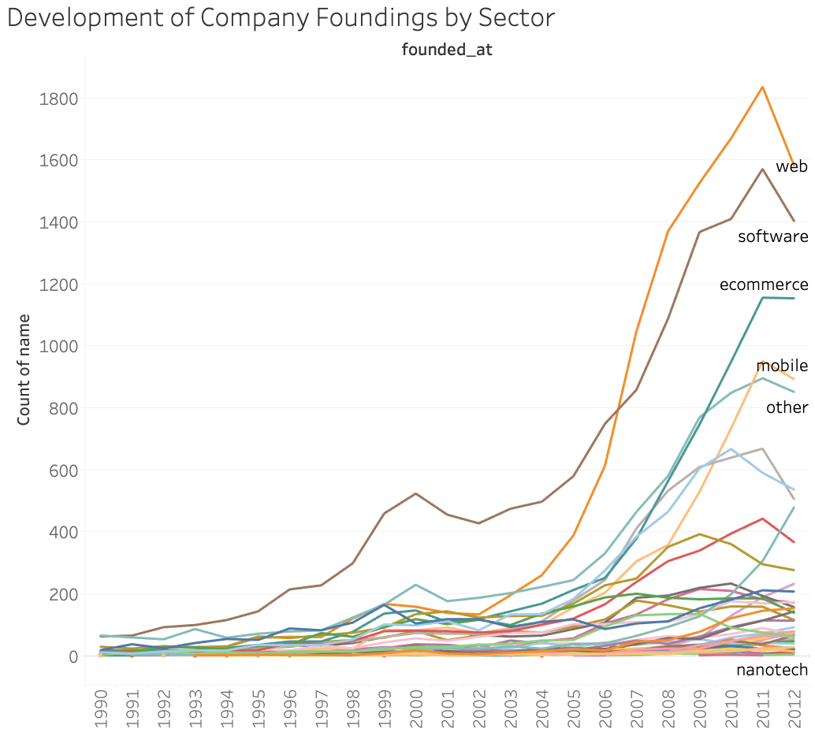
Development over time

Slide 8
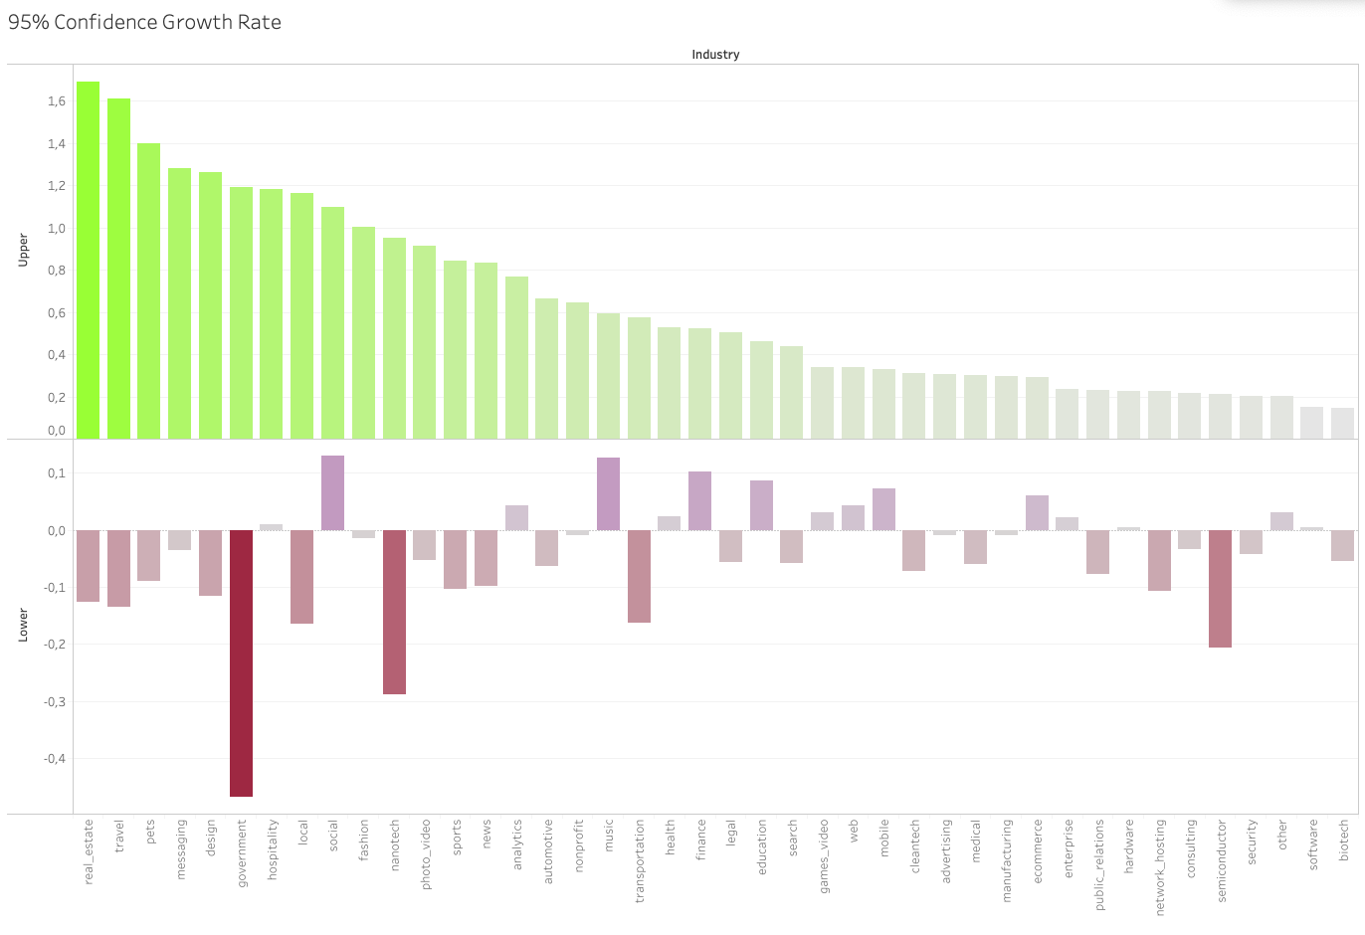

Slide 9
Factors for Success 🏆
Investigating the correlation of industries, funding amounts and exit options
Underlying Assumption:
Indicators for Success are:
Not being closed
Receiving funding
Being acquired or going public

Slide 10
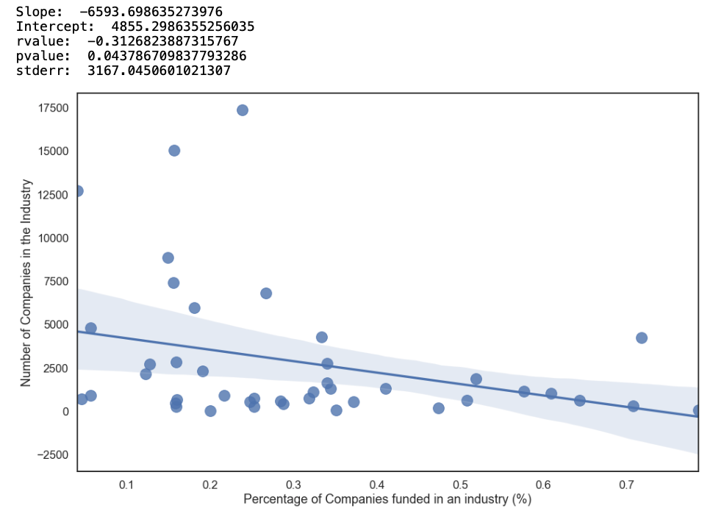
Hypothesis: There is a positive correlation between the amount of companies founded and the amount of funding by sector.
❌
✔️

Slide 11
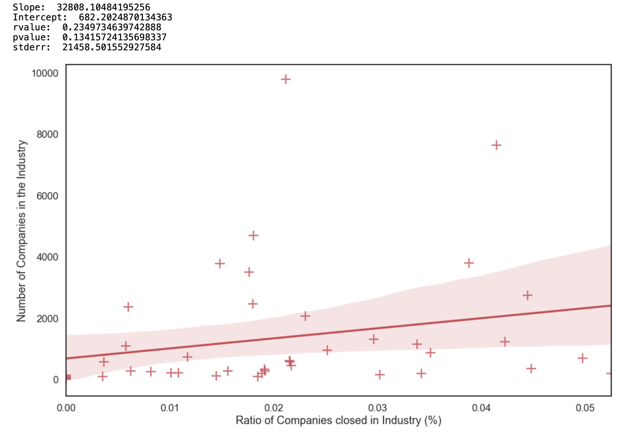
Hypothesis: There is a positive correlation between the amount of companies founded and closed in a sector?
❌

Slide 12
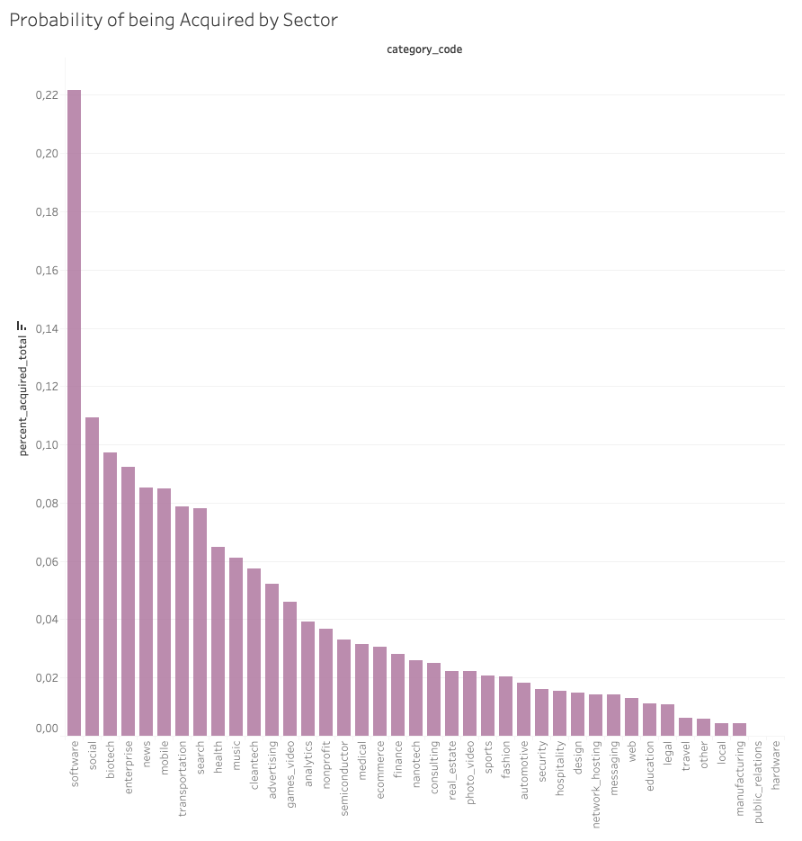
What is the probability of being acquired by sector?

Slide 13
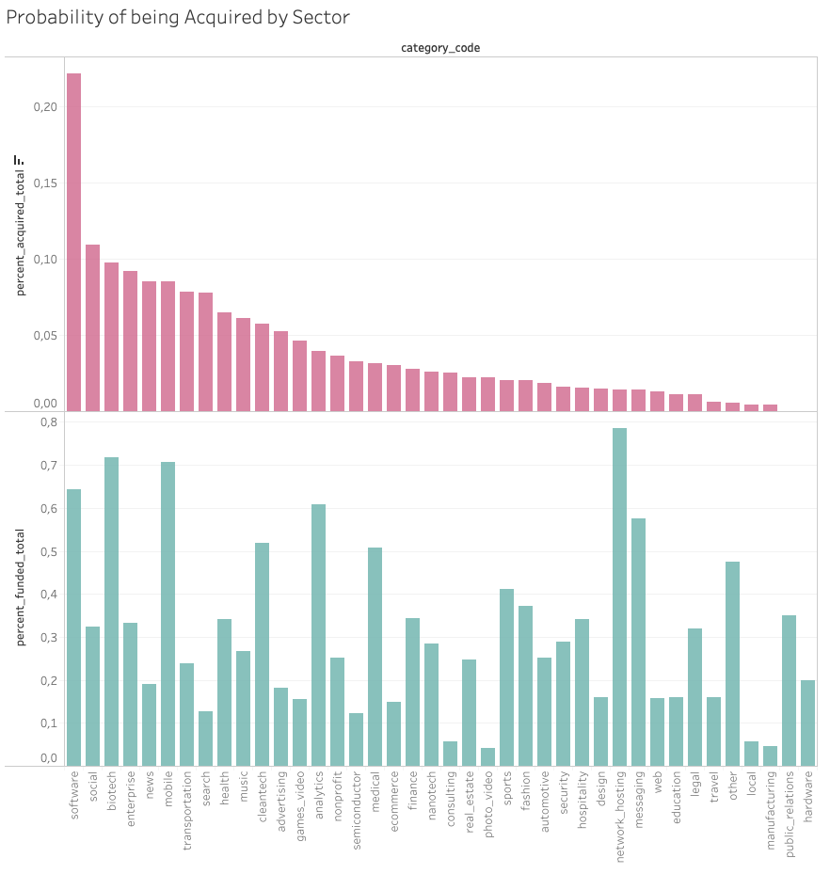
What is the probability of being funded and acquired?

Slide 14
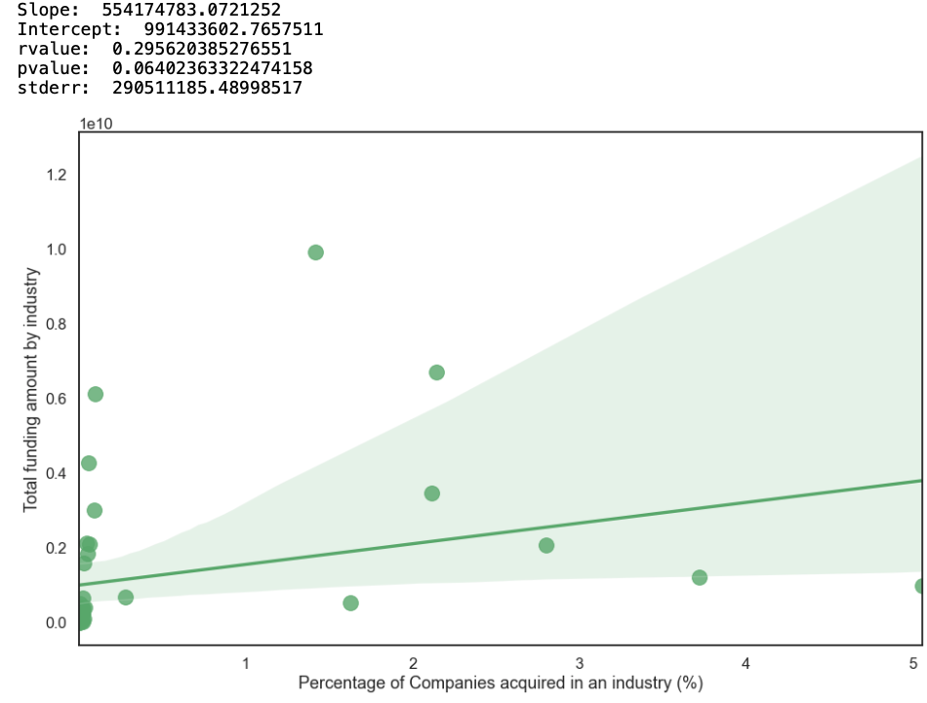
Hypothesis: There is a correlation between the amount of funding and the probability of being acquired.
❌

Slide 15
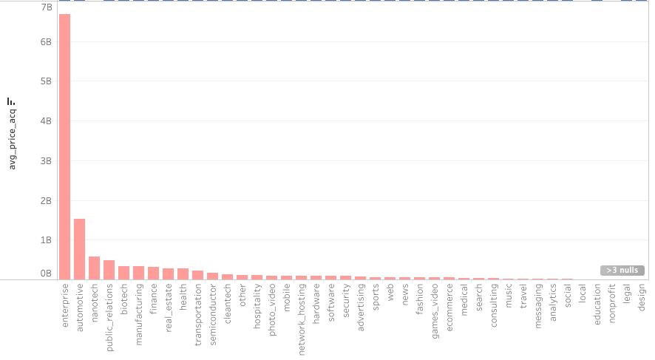
Which Sector pays the most for an Acquisition?

Slide 16

What about the Unicorns?! ✨
Unicorn
Noun - u· ni· corn, Plural: u· ni· corns
“A Start-up valued at
1 Billion USD before
an Exit or and IPO”
☹️

Slide 17
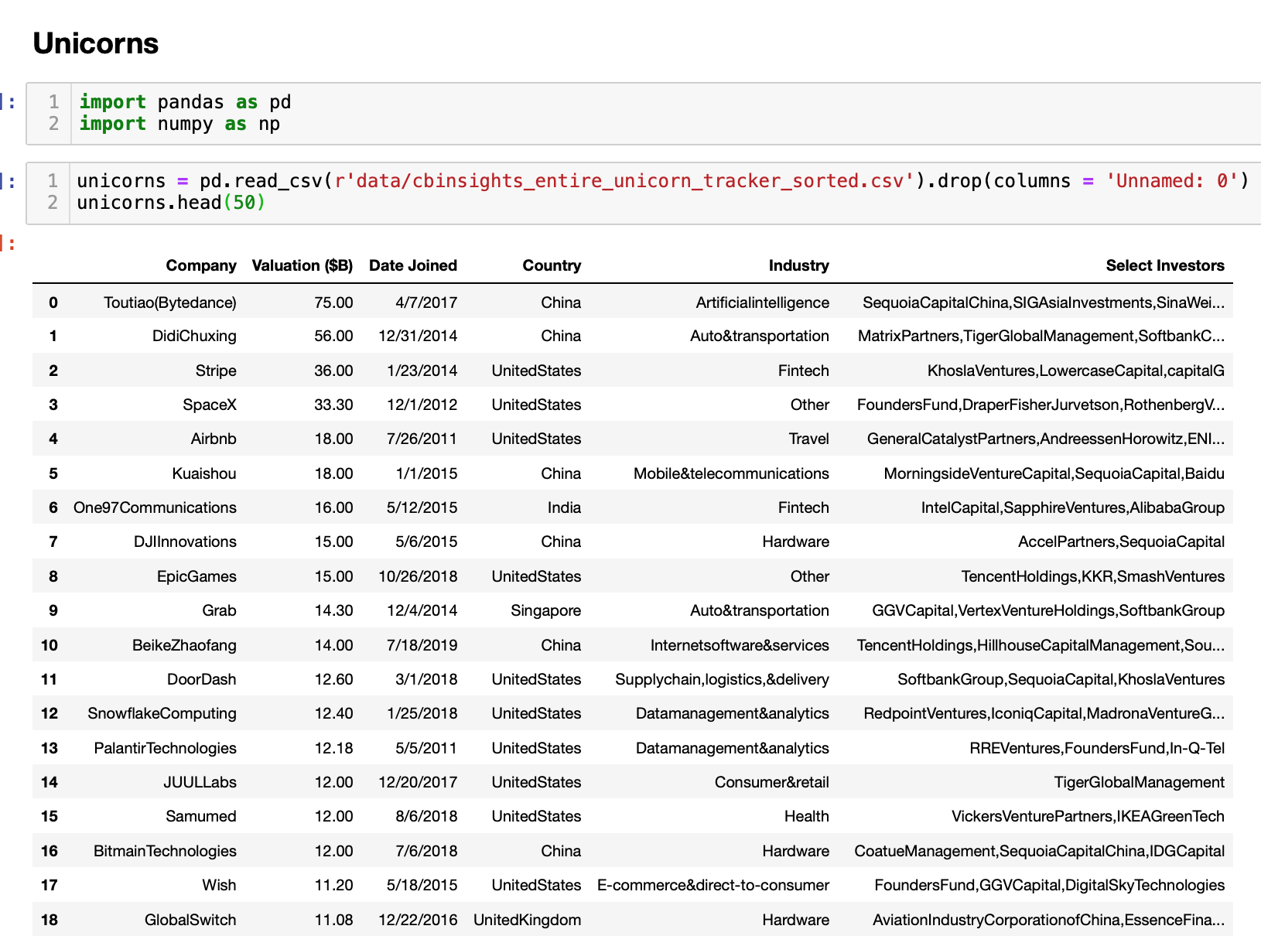
🦄 Who are the Unicorns? 🦄

Slide 18
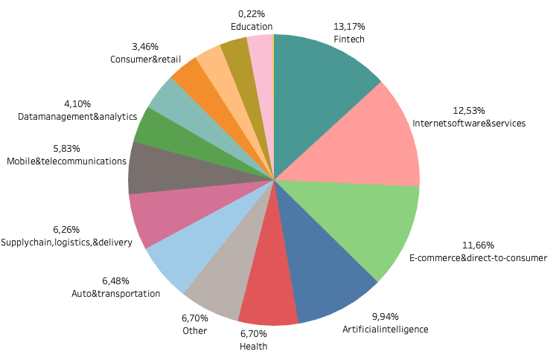
🦄 Unicorns by Sector 🦄

Slide 19
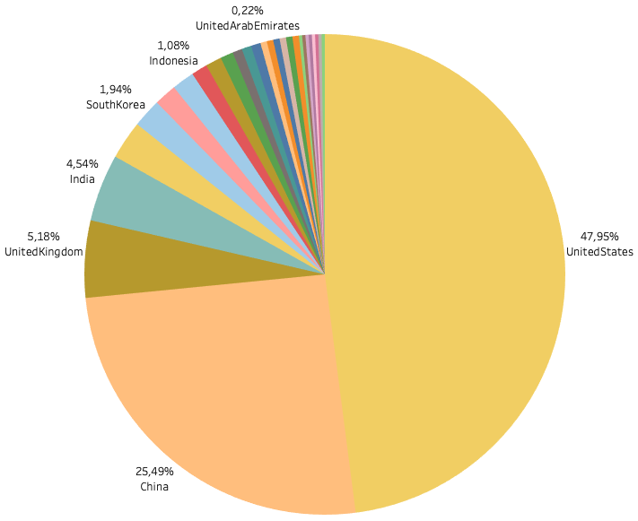
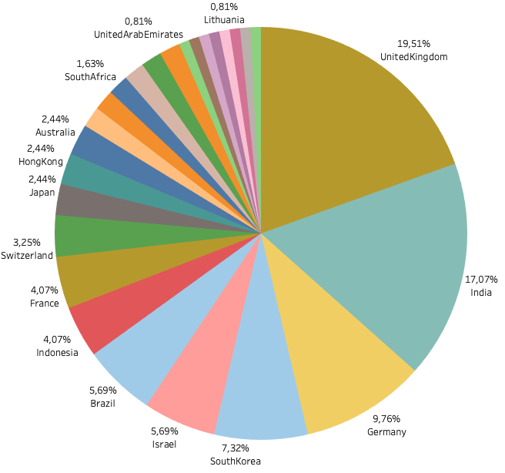
🦄Unicorns by Country 🦄

Slide 20
Summary of results
What Startup should I found to maximize my chances of Success?

Slide 21
Summary of the Results 🧩
Recommendations for your Startup
DO’s
Go to the US
Found a software or enterprise company or an enterprise software company
Be acquired as an enterprise software
Hire a Data Analyst 🍀

Slide 22
Improvements and Follow-on Analysis
Correlation between funding rounds and follow on rounds
Best Investors for Success by industry
Correlation between Funding Amount and Founder Education
Correlation between Success and Founder Education
Entrepreneur Characteristics and Success

Slide 23
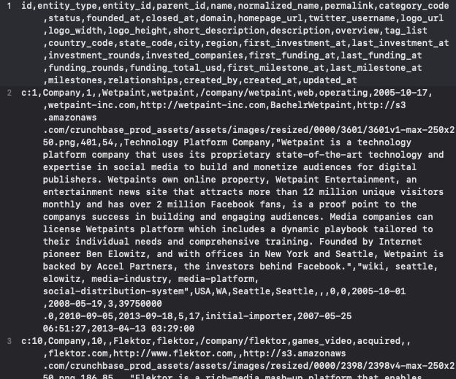
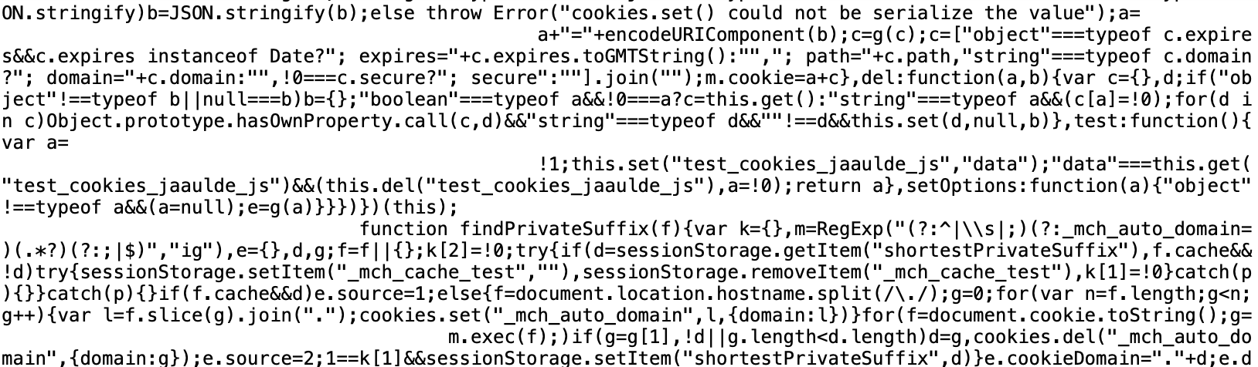
About the Data 🌈
CSV Files from Kaggle – Crunchbase Snapshot
Webscrapping from CB Insights Unicorn Tracker

Slide 24


Thank you very much!! 🤹🏼‍♀️ Q & A
github.com/VickyZauner
linkedin.com/in/victoriazauner/

